Slide 1
Chapter 1 Introduction
Unix, Programming Languages, Program Development, and Other Definitions

Slide 2
A bit about UNIX
UNIX is an operating system
Manages the software and hardware on the computer
Developed at Bell Labs in the late 1960s
Notes:
Developed in assembly language, and re-written in C in 1972 (makes it much more easily ported to different systems with relatively small effort)

Slide 3
Why use/learn UNIX?
Basis for many modern (non-Windows) operating systems
“Unix philosophy”
Create small, modular utilities that do one thing well
Combine them in powerful ways
Single file system – “everything is a file”
Read more at the How-To Geek site
Notes:
Basis for Linux, MacOS
Everything is a file: stdin, stdout, stderr

Slide 4
Directories, pathnames
directories have hierarchical, tree-like structure
each directory can contain files and subdirectories
full names of UNIX files are pathnames, including directories
/home/chochri/111/junk.txt
/home
…
chochri
…
111
…
junk.txt

Slide 5
Example
/home/chochri/111/junk.txt (absolute pathname)
if _current working directory_ is /home/chochri/111
can use junk.txt (relative pathname)
if _current working directory_ is /home/chochri
can use 111/junk.txt (also a relative pathname)

Slide 6
Why use/learn UNIX?
Also:
It can save your life from cloned dinosaurs run amok

Slide 7
UNIX
UNIX is an operating system
Manages the software and hardware on the computer
Handles all I/O
Manages computer systems resources
Handles execution of programs
Mediates access by processes to the:
CPU
Memory
Storage

Slide 8
What is a CPU?

Slide 9
CPU
Central processing unit
Processor
Component in a computer that interprets instructions and processes data
The “brains” of the computer
Notes:
Interprets instructions: retrieves an instruction from memory, decodes it, and executes it, and then returns the results back to memory if necessary. For an instruction to be executed, it must first be in memory (RAM)
Each time the CPU does a retrieve/decode/execute/return results cycle is a CPU cycle. CPU speed is measured in terms of GHz, which is the number of billions of CPU cycles per second.

Slide 10
How are memory and storage different?

Slide 11
“Simple” answer:
memory
Short-term data access
RAM (random access memory)
CPU can access easily
In use while computer is powered on (volatile)
Where computer stores “what it is thinking about”
More memory –> computer can “think” about more at same time
storage
Long term storage
Hard disk drive (HDD)
Info in storage must be loaded into memory for CPU to access it
Persists when power is turned off
More storage → allows you to store more on your computer but doesn’t really affect performance
Both
Measured in bytes, kilobytes, megabytes, etc.

Slide 12
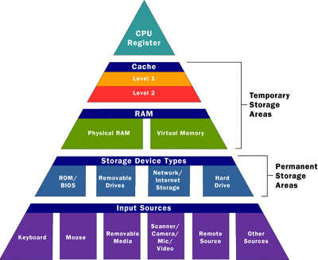
Complex answer:
It’s a hierarchy
… beyond the scope of this course ...
Source: computer.howstuffworks.com

Slide 13
So …back to the CPU
We said a few slides back that the CPU extracts instructions from memory and executes them
? Are the available instructions the same on all computers?
Notes:
Different instruction sets on different platforms / processors

Slide 14
Instructions
Also known as machine language
May specify:
Particular registers for arithmetic, addressing, or control functions
Particular addressing modes to interpret the commands
Particular memory locations or offsets

Slide 15
Machine language instructions
Types of instructions:
Data handling and memory:
Set a register to a value
Copy data from memory to a register
Copy data from a register to memory
Read or write data from/to hardware devices
Arithmetic operations
Add, subtract, multiply, divide
Bitwise operations
Comparison
Control flow operations
Branch to another location
Conditionally branch
Call another block of code
& more …

Slide 16
What does machine language look like?

Slide 17
What does machine language look like?
0000111100001111
0010111100001111
0011001111000011
0011001111000011
0001101111000011
0110001111000011
0001010101111000
0011010100111100
0010101101000011

Slide 18
What does machine language look like?
Or in hexadecimal instead of binary:
8B542408 83FA0077 06B80000 0000C383 FA027706 B8010000 00C353BB 01000000 C9010000 008D0419 83FA0376 078BD98B B84AEBF1 5BC3

Slide 19
That type of low-level language seems hard to work with, doesn’t it?

Slide 20
Languages: low-level … high-level
Machine language
Assembly language:
Symbolic names for both instructions and locations
Assembler is the program that does this translation

Slide 21
What does assembly language look like?
fib:
mov edx, [esp+8]
cmp edx, 0
ja @f
mov eax, 0
ret
@@:
cmp edx, 2
ja @f mov eax, 1
Ret
…

Slide 22
Is machine language portable?

Slide 23
No.
Machine language, the set of instructions(operations) available on a machine, and the particular binary codes that correspond to each instruction, are specific to a particular type of computer (a computer architecture )
So a program written in machine language for one computer generally can NOT be executed on another computer. That is, the program is not portable.

Slide 24
Is assembly language portable?

Slide 25
No.
One-to-one mapping from assembly language instructions to machine language instructions
Thus, also not portable because specific to a particular computer architecture and the associated instruction set

Slide 26
Machine Languages, Assembly Languages and High-Level Languages
Machine language (1940s)
language that computer can directly process
defined by its hardware design
strings of numbers (ultimately reduced to 1s and 0s) that instruct computer to perform most elementary ops one at a time.
Machine dependent—a particular machine language can be used on only one type of computer.
Assembly languages (early 1950s)
English-like abbreviations to represent elementary operations.
Assemblers
translate assembly-language to machine language.

Slide 27
Machine Languages, Assembly Languages and High-Level Languages
High-level languages
Grace Hopper
Single statements can accomplish substantial tasks
Fortran (1954), COBOL (1959)
C is a high-level language
As are C++, Java, Fortran, etc.
Compilers
Convert high-level language to machine language
Programmers write instructions that look almost like everyday English and contain commonly used mathematical notations.
A payroll program written in a high-level language might contain a single statement such as
grossPay = basePay + overTimePay;

Slide 28
Machine Languages, Assembly Languages and High-Level Languages
Compiling a high-level language program into machine language can take a considerable amount of computer time
Longer in the past than now
Interpreter programs developed to execute high-level language programs directly
But run slower than compiled programs

Slide 29
History of C
C (1969-1973)
Evolved by Dennis Ritchie (Bell Labs) from two previous programming languages, BCPL and B
Used to develop UNIX
Used to write modern operating systems
Hardware independent (portable)
By late 1970's C had evolved to "Traditional C”
Standardization
Many slight variations of C existed, and were incompatible
Committee formed to create a "unambiguous, machine-independent" definition (ANSI, American National Standards Institute)
Standard created in 1989, updated in 1999

Slide 30
The C Standard Library
C programs consist of pieces/modules called functions
A programmer can create his own functions
Advantage: the programmer knows exactly how it works
Disadvantage: time consuming
Programmers will often use the C library functions
Use these as building blocks
Avoid re-inventing the wheel
If a premade function exists, generally best to use it rather than write your own
Library functions carefully written, efficient, and portable

Slide 31
C and C++
C++
Superset of C developed by Bjarne Stroustrup at Bell Labs
"Spruces up" C, and provides object-oriented capabilities
Object-oriented design very powerful
10 to 100 fold increase in productivity
Dominant language in industry and academia

Slide 32
Basics of a Typical C Program Development Environment
Program is created in the
editor and stored on disk.
Phases of C Programs:
Edit
Compile
Preprocessor
Assembler
Link
Load
Execute
Editor
Disk
Preprocessor program
processes the code.
Preprocessor
Disk
Assembler creates assembly language version and then the object code & stores it on disk.
Assembler
Disk
Linker
Disk
Linker links the object
code with the libraries.
Primary Memory
Loader
Loader puts program
in memory.
Disk
.
.
.
.
.
.
Primary Memory
CPU
CPU takes each
instruction and executes it, possibly storing new data values as the program executes.
.
.
.
.
.
.
Notes:
First, write an algorithm, will show the logic and approach (steps or method) that will solve the problem.
A well-thought out algorithm usually makes it much more straightforward to code the program with fewer problems, fewer hours spent writing your programs.

Slide 33
Typical C Development Environment
Phase 1: Editing
consists of editing a file with an editor program, normally known simply as an editor.
Type a C program (source code) using the editor.
Make any necessary corrections.
Save the program.
C source code filenames often end with “.c” (lower case)

Slide 34
Typical C Development Environment
Phase 2: Compile the program - two sub-steps
A preprocessor program executes automatically before the compiler’s translation phase begins.
The compiler’s translation involves the assembler, which produces an assembly language version, and then converts that to object code.
typing the compile command kicks off both
Can capture the result of the preprocessor (will end in a .i) by compiling with the following flag: gcc –E prog.c
Can capture the result of the assembler (will end in a .s) by compiling with the following flag: gcc -S prog.c
Can capture the file containing the object code (will end in a .o) by compiling with the following flag: gcc –c prog.c
Can capture all the intermediate files by compiling with the following: gcc –save-temps prog.c
Notes:
Preprocessor does a pre-pass of the program looking for special statements, or directives

Slide 35
Typical C Development Environment
Phase 3: Linking
The object code produced by the C compiler typically contains “holes” due to “missing parts” -- code that the the programmer has “promised” the compiler will be available
A linker links the object code with the code for the missing functions to produce an executable program.
If the program compiles and links correctly
an executable image is produced

Slide 36
Typical C Development Environment
Phase 4: Loading
Before a program can be executed, it must first be placed in memory.
This is done by the loader, which takes the executable image from disk and transfers it to memory.
Additional components from shared libraries that support the program are also loaded.

Slide 37
Typical C Development Environment
Phase 5: Execution
Finally, the computer, under the control of its CPU, executes the program one instruction at a time.
Some modern computer architectures can execute several instructions in parallel.

Slide 38
Another Way To Look At It:
Flow Chart for Creating a Computer Program (figure 1.1. from book)

Slide 39
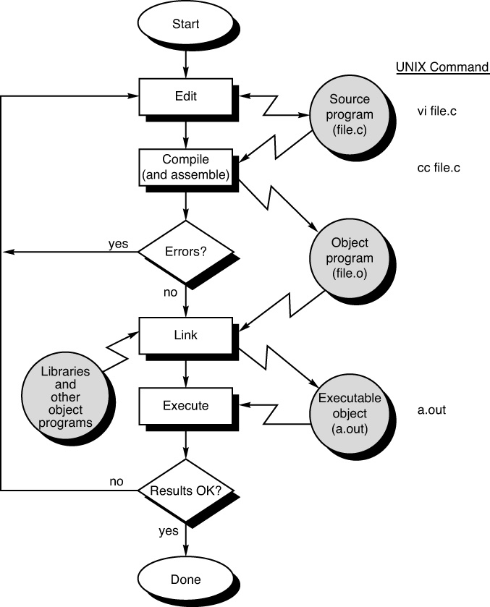

Slide 40
Simple program: evenOrOdd.c
/* evenOrOdd.c
determines if a number
is even or odd
Cathy Hochrine
1/16/17
*/
#include <stdio.h>
int main(void){
int aNumber = 12;
if ( (aNumber % 2) == 0)
printf("%i is even\n", aNumber);
else
printf("%i is odd\n", aNumber);
return 0;
}
To compile:
gcc evenOrOdd.c
… to produce executable file called a.out
OR
gcc –o evenOrOdd evenOrOdd.c
… to produce executable file called evenOrOdd

Slide 41
Simple program: evenOrOdd.c
By the way…
The program instruction in bold from the previous page:
int aNumber = 12;
corresponds to the following 3 more primitive assembly language instructions (for the x86_64 processor on our system):
pushq %rbp
movq %rsp, %rbp
movl $12, -4(%rbp)

Slide 42
How to copy files from one machine to another ...
Assume you are in the directory of your choice on your local machine, and you want to copy a file testing.c from a directory named Example in your home directory on the machine imp13.cs.clemson.edu
scp imp13.cs.clemson.edu:~username/Example/testing.c .
More generally:
scp remote_host_name:remote_pathname current_dir
More File Transfer help: http://www.cs.clemson.edu/~chochri/HowTo/FileTransfers.pdf

